Slide 1

Final Presentation
Ripunjay Singh

Slide 2

WHAT ARE we discussing today?
INTRODUCTIONS
EMAIL HEADERS
EMAIL PHISHING
EMAIL HEADER ANALYSER
TECHNICAL SKILLS
PROFESSIONAL SKILLS
NEXT STEPS
QUESTIONS

Slide 3

Mentee ripunjay singh
STUDENT, NEW JERSEY CITY UNIVERSITY
SENIOR, B.S COMPUTER SCIENCE
HOBBIES
READING AND WRITING
TRAVELLING
CODING

Slide 4
EMAIL HEADERS
What are they?
The email header is the routing information for successfully delivering the email, that contains information about the sender, recipient, email's route to get to the inbox and various authentication details. The email header always precedes the email body.
Why are they important?
The email header is important due to the following reasons:
Analysis to determine malicious attacks
Email tracking
Routing of information for successful transmission
Notes:
EMAIL THAT IS “FROM” IS NOT ALWAYS THE SAME IS “ENVELOPE-SENDER”.

Slide 5
EMAIL PHISHING
Phishing is the fraudulent attempt to obtain sensitive information such as usernames, passwords and credit card details by disguising oneself as a trustworthy entity in an electronic communication.
Notes:
1. Phishing accounts for 90% of data breaches.
2. Phishing attempts have grown 65% in the last year
3. Around 1.5m new phishing sites are created each month (Webroot)

Slide 6
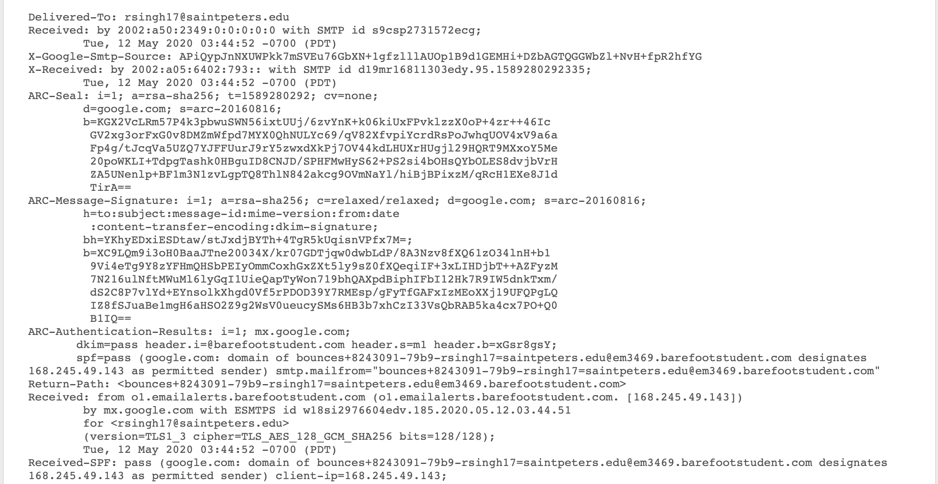
EMAIL_HEADER_ANALYSER
Python 3.7
Pandas ( for data manipulation )
Seaborn and Matplotlib ( for visualization )
Jupyter Notebook
API’s
Tools Used

Slide 7

CODE VIDEO

Slide 8
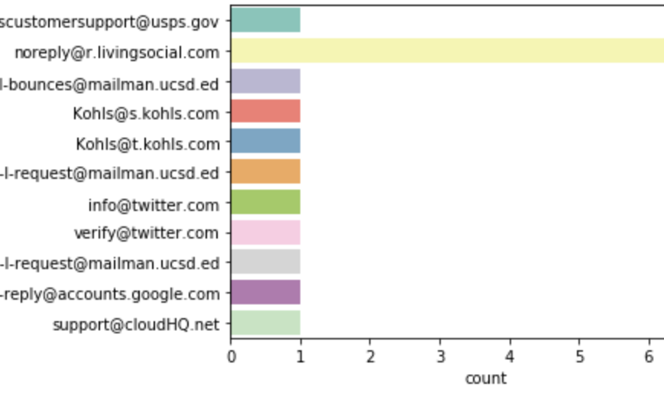
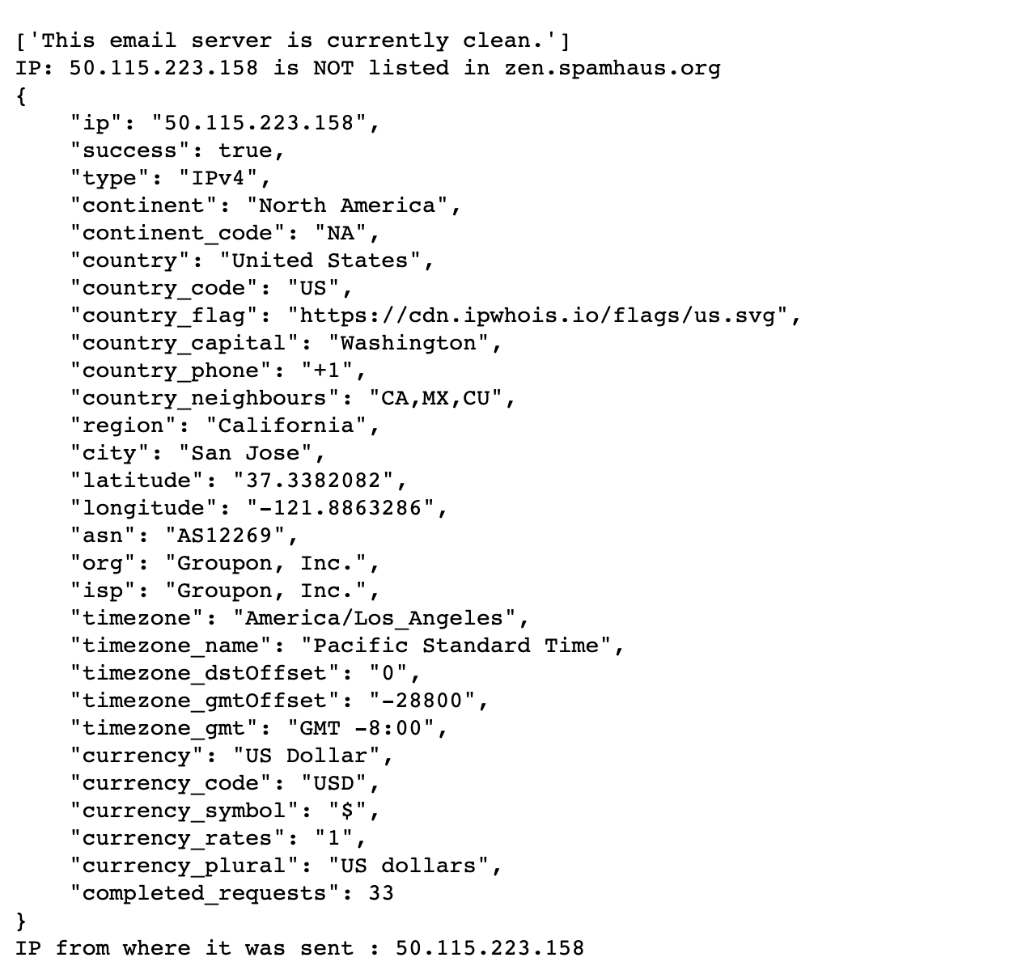
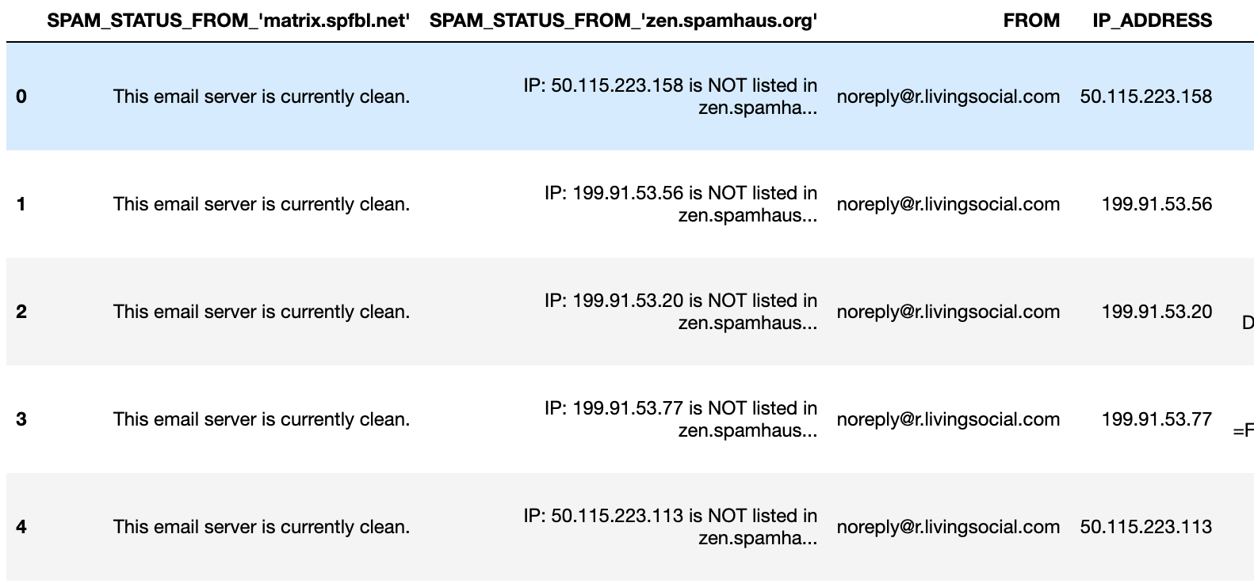
SNAPSHOTS

Slide 9
Technical skills
CIS BENCHMARKS
FIREWALLS
MITRE ATT&CK FRAMEWORK
RFC
DNS Blacklists
OWASP
WINDOWS EVENTS
HOST FIREWALL/AV
DATA SCIENCE
USING MATPLOTLIB AND SEABORN TO VISUALIZE DATA

Slide 10
Professional skills
LinkedIn Tips to gather more views and be up in recruiter searches
Resume tips to make sure that all the information is clear
Networking techniques that will assist in connecting with recruiters and making sure the interest is displayed
Interview preparation techniques

Slide 11
Next steps
CREATE A GUI
1
ADD MORE DETAILS TO GEOLOCATION DATA
2
AUTOMATE THE PROCESS AND STORE DATA ON A DAILY BASIS
3

Slide 12

Thank You
ANY QUESTION?

